Slide 1


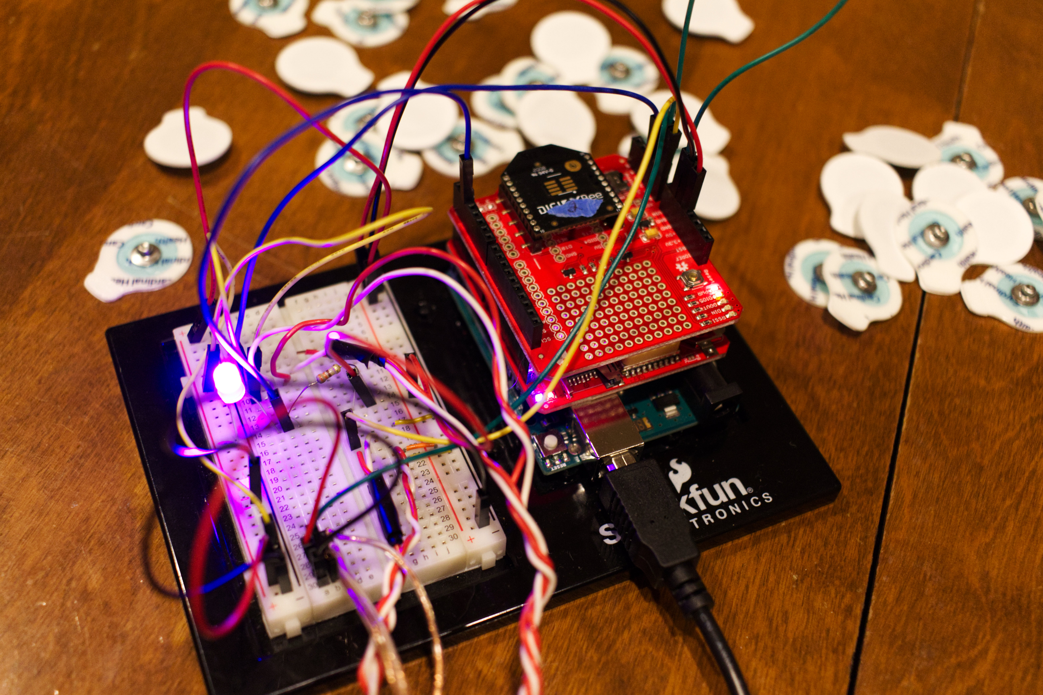
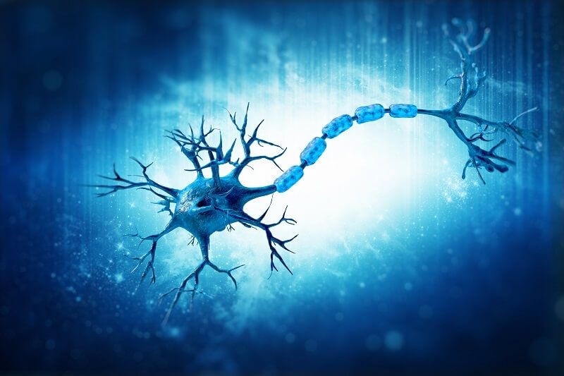
Wireless Multi Electromyogram Data storage
Andrew Nyland ~ Michael Vidunas ~ Andrew Walsh
https://gitlab.com/alnyland/emg-multi

Slide 2
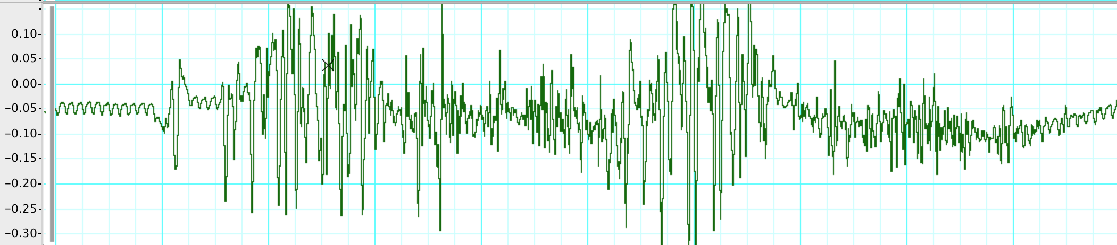
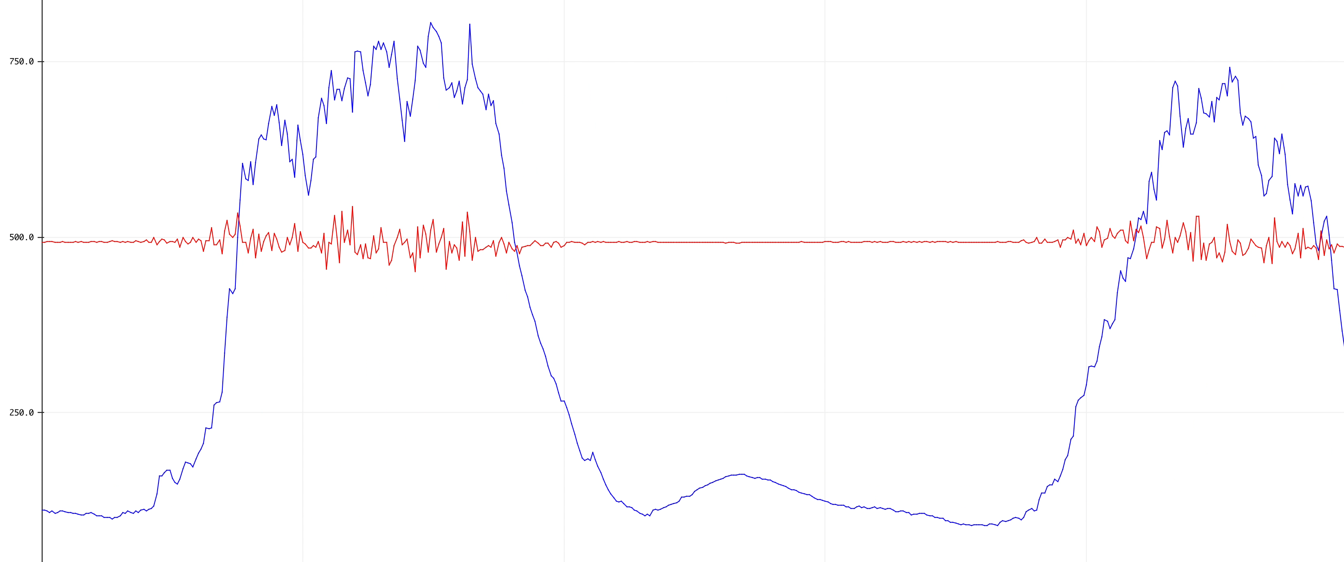
Outline
Above - Inspiration: Electromyogram data recorded in 2018 on lab equipment at Virginia Tech in Neuroscience Lab 1
Below – Current project: Results recorded with our <$500 project, supports web app control of 2+ muscle sensors
Blue: rectified/integrated data used in these slides, Red: raw potential
Materials
Purpose
Assembly
Implementation
Testing
Results

Slide 3
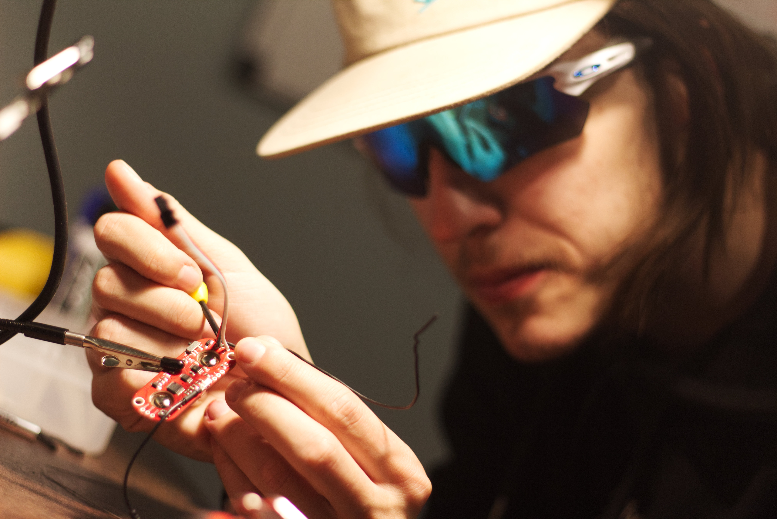
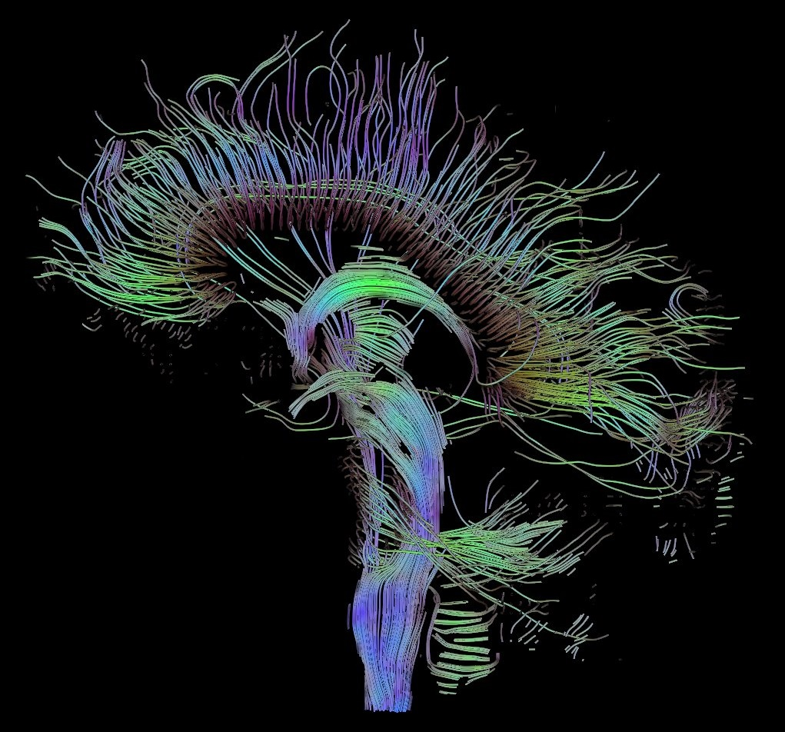
Materials
3 MyoWare sensors With 9 electrodes per person per test
Raspberry PI, Arduino Uno
Power-bank(s)
SSD board to store data via PI
LED

Slide 4
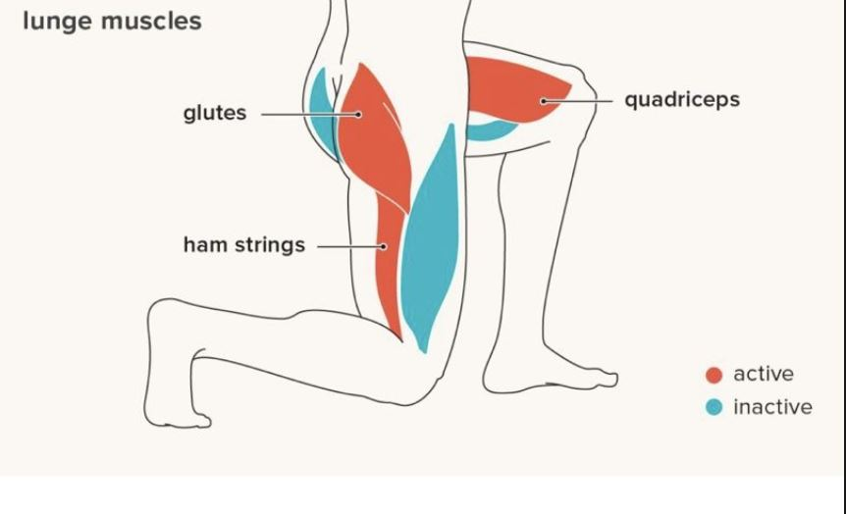
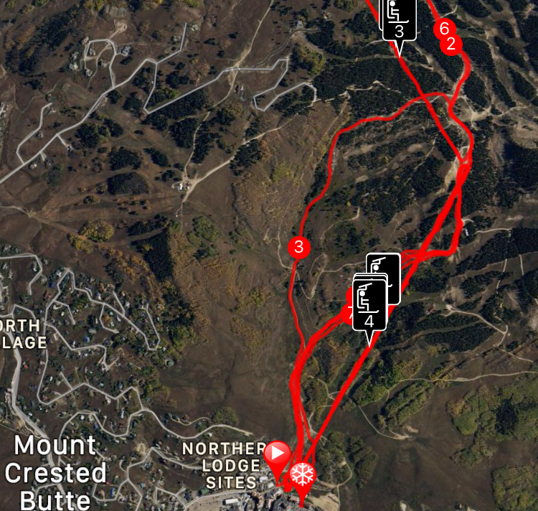
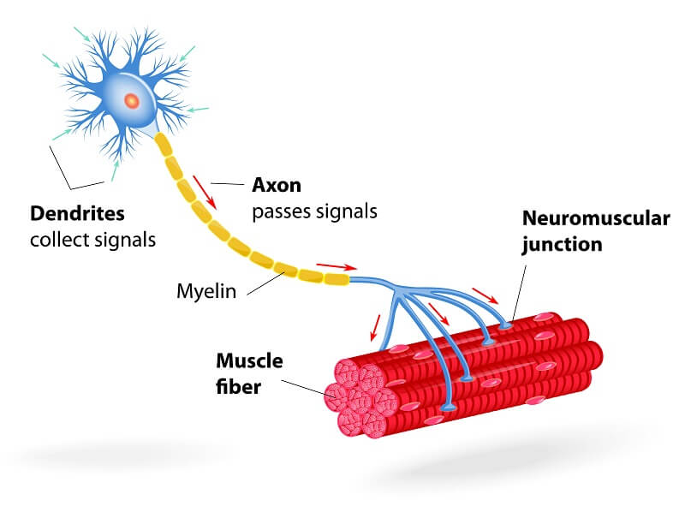
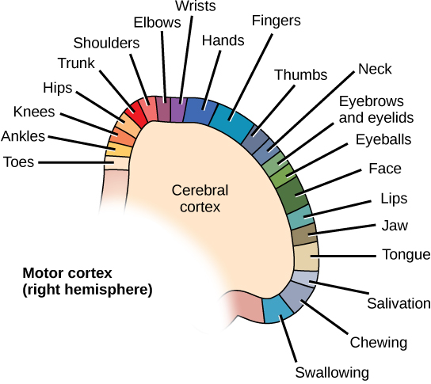
Purpose & Goals
Track different muscle groups output in tandem
analyze differences in test subjects
Analyze real-time physical position and movement

Slide 5
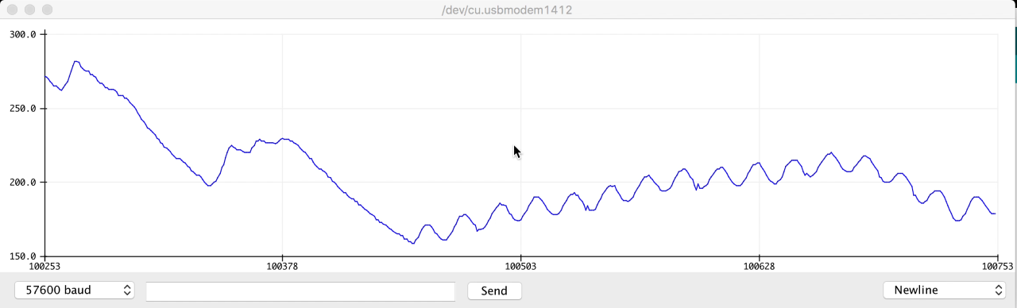
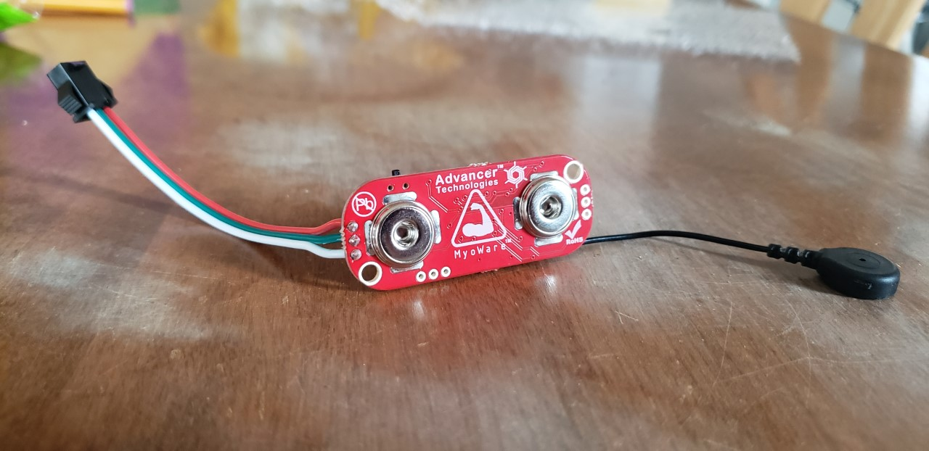
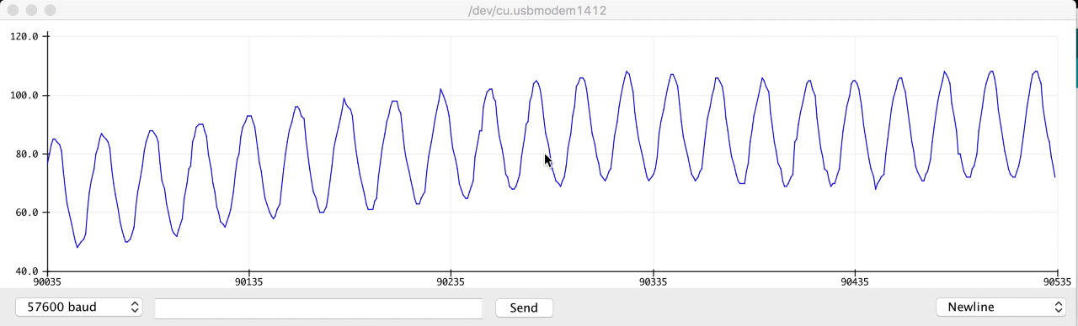
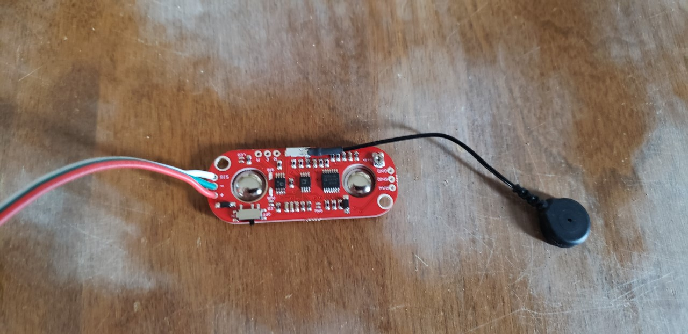
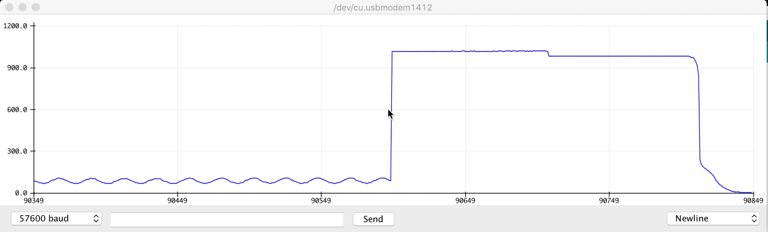
Assembly – Initial Attempt
Configuring reliable connections to the sensors.
Calculating bandwidth required to pull data from each sensor concurrently
Soldering electrode wires to sensors
4 bytes = timestamp
3 * 2 bytes = 6 bytes of sensor data
1kHz = 10,000B = 80,000 bits/sec
Benchmarked ADC Converters:
1000 x 6 samples computes in
Roughly 0.61 seconds
Leaves 39% of time for transmitting, etc

Slide 6
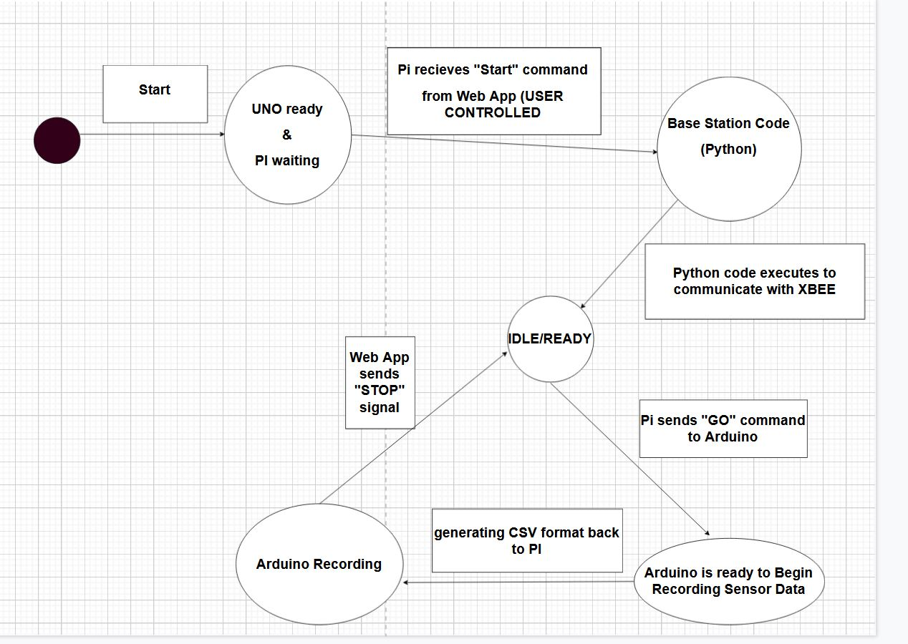

Functional Flowchart

Slide 7
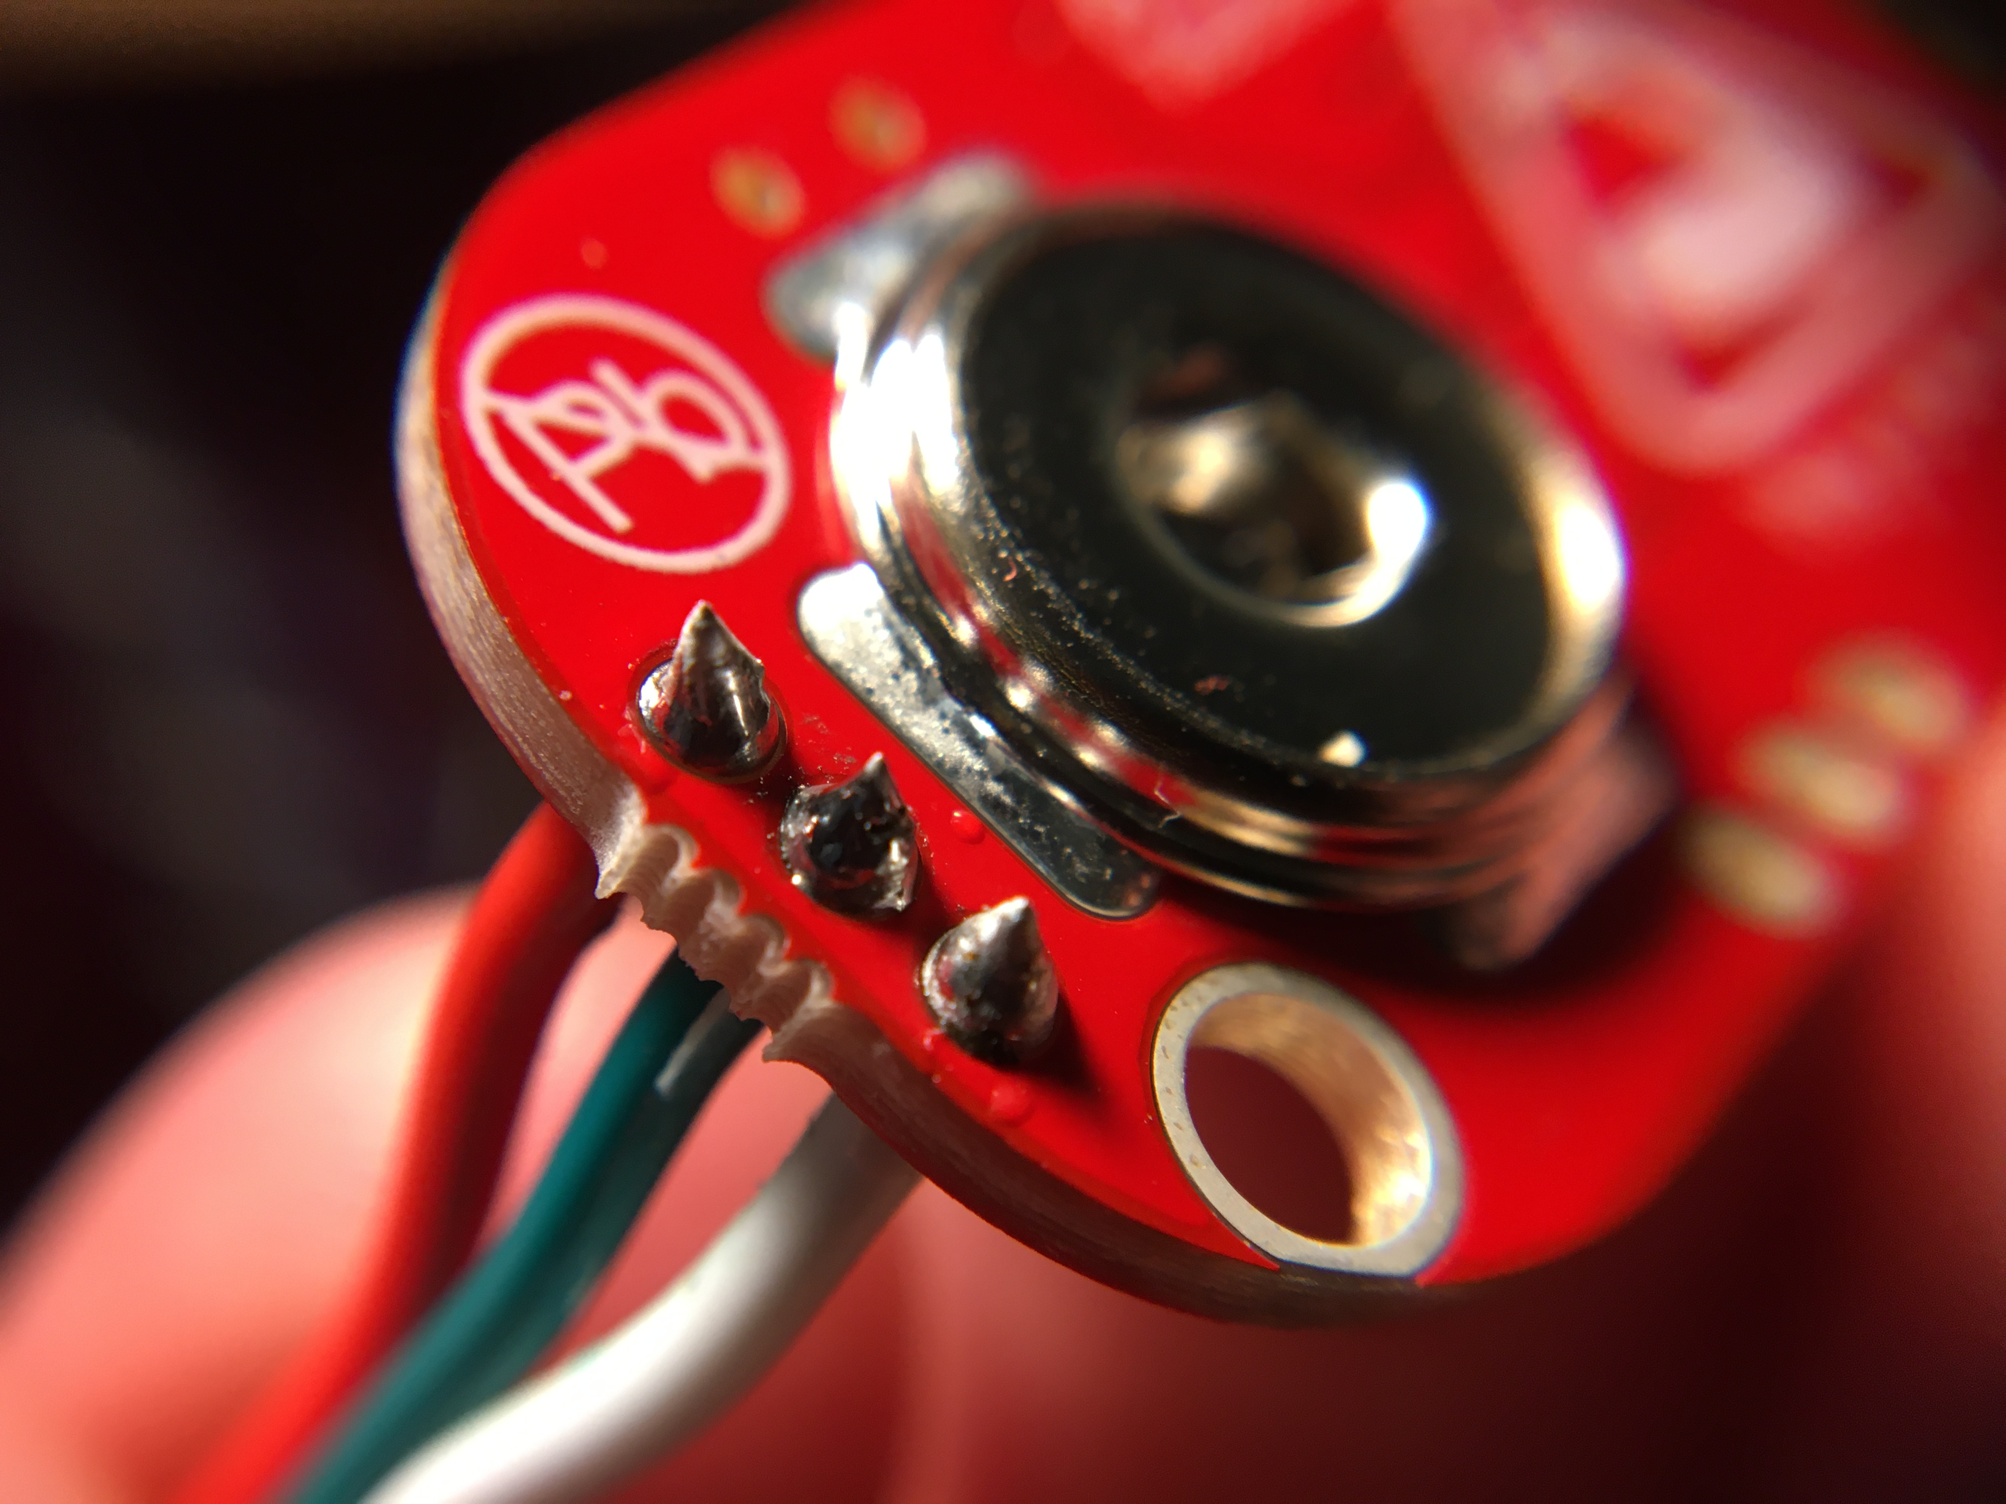
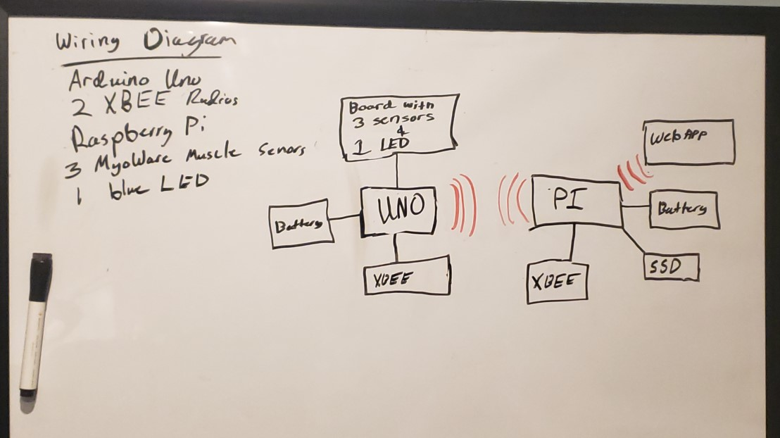
Wiring Diagram

Slide 8
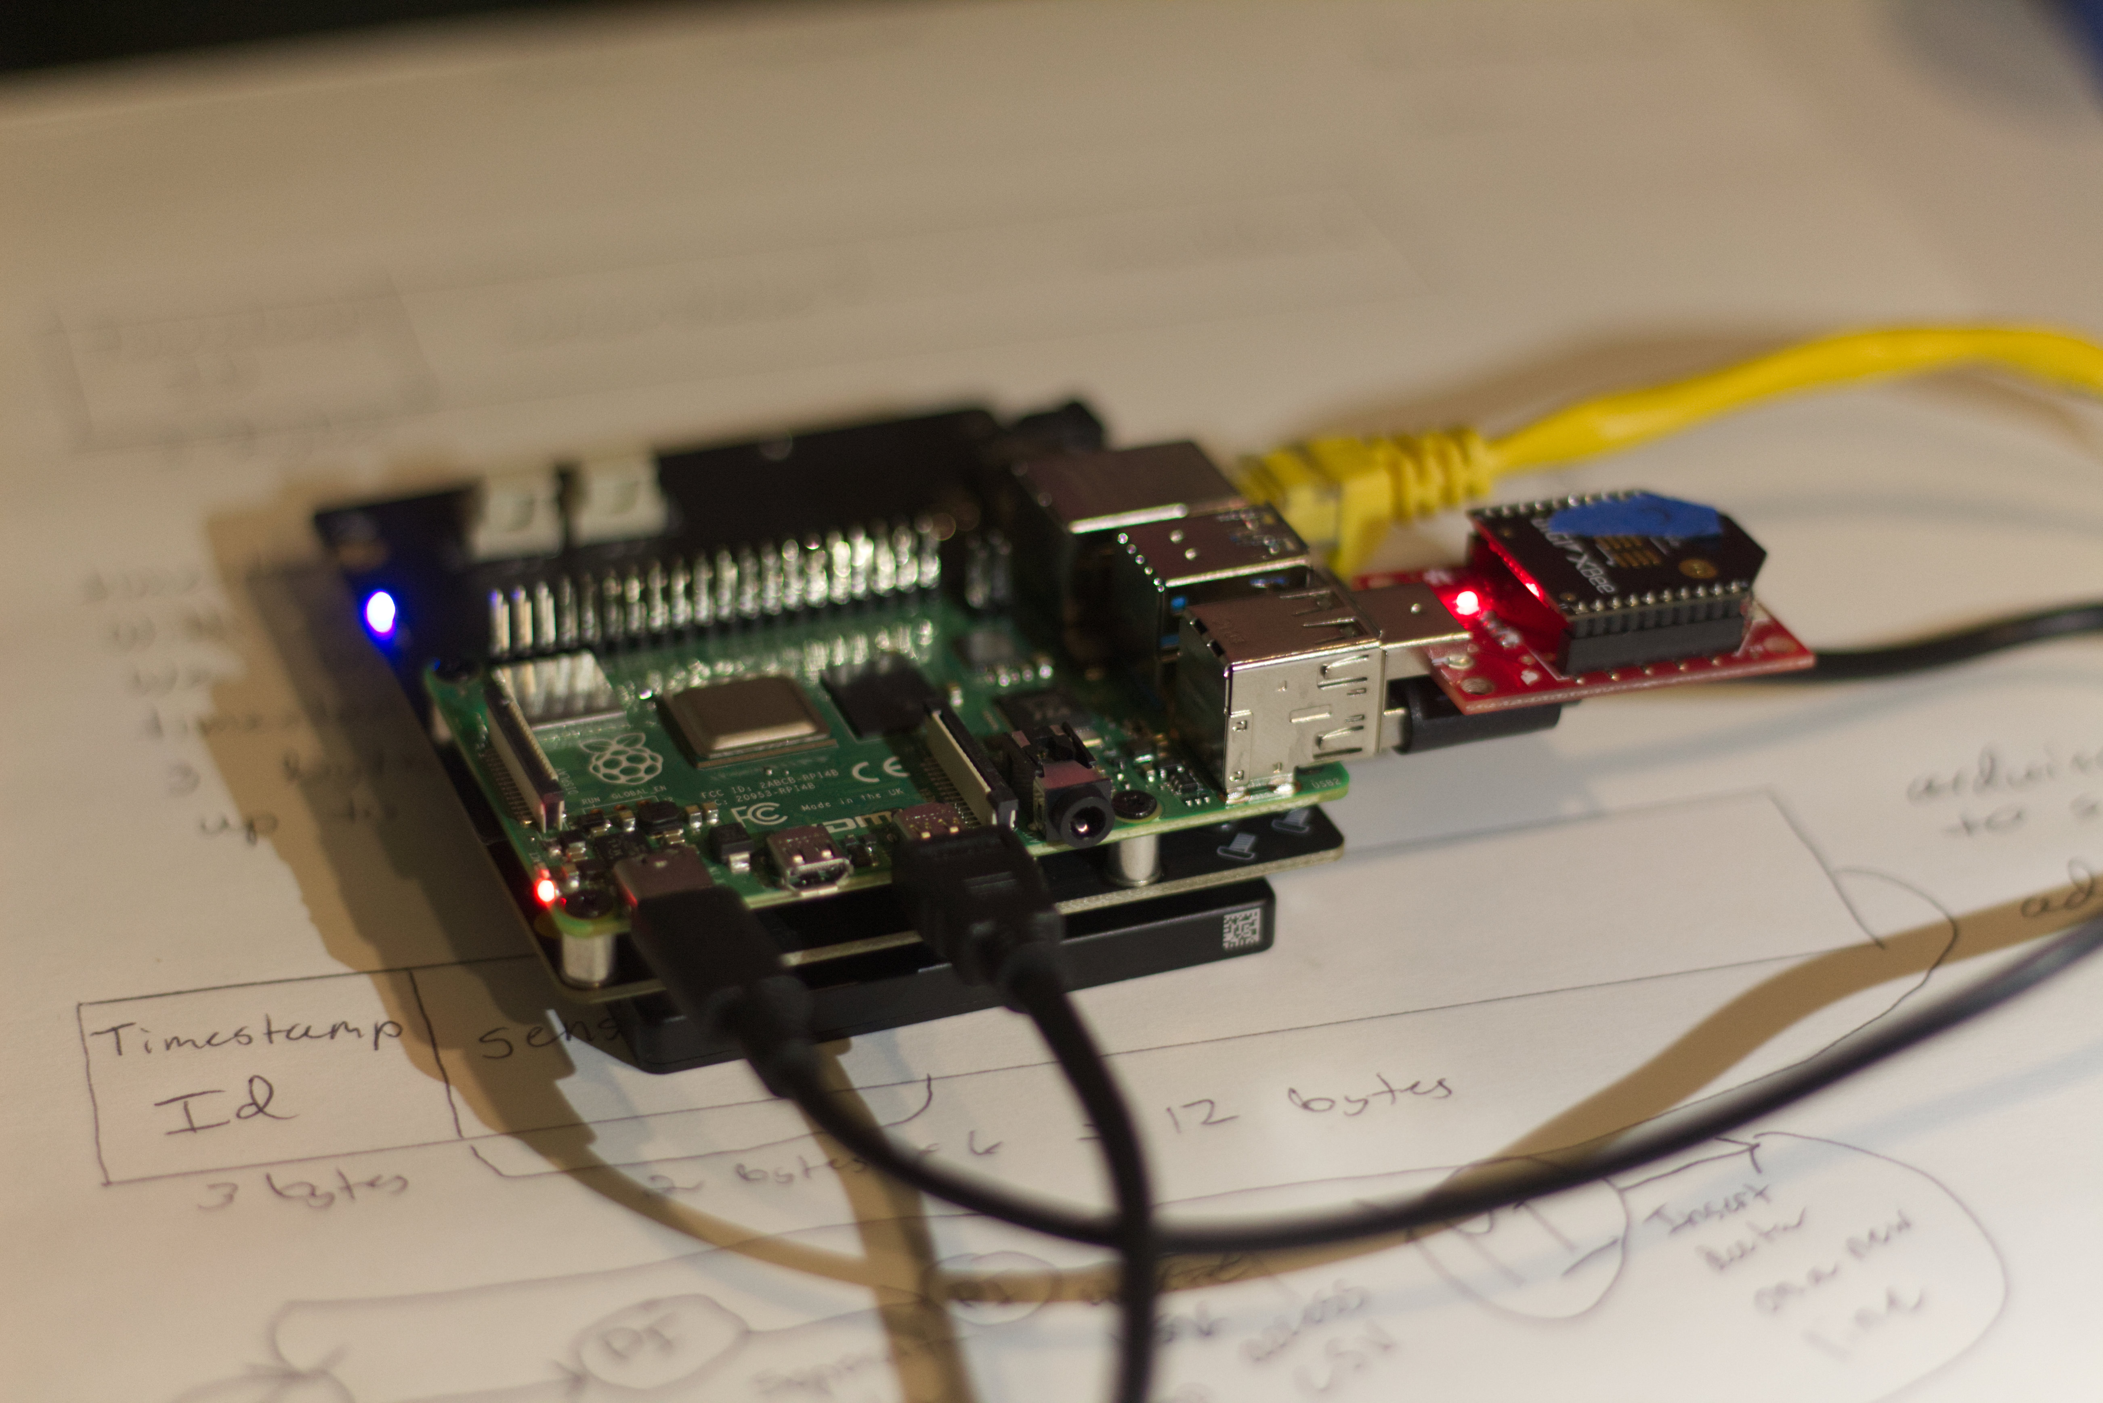
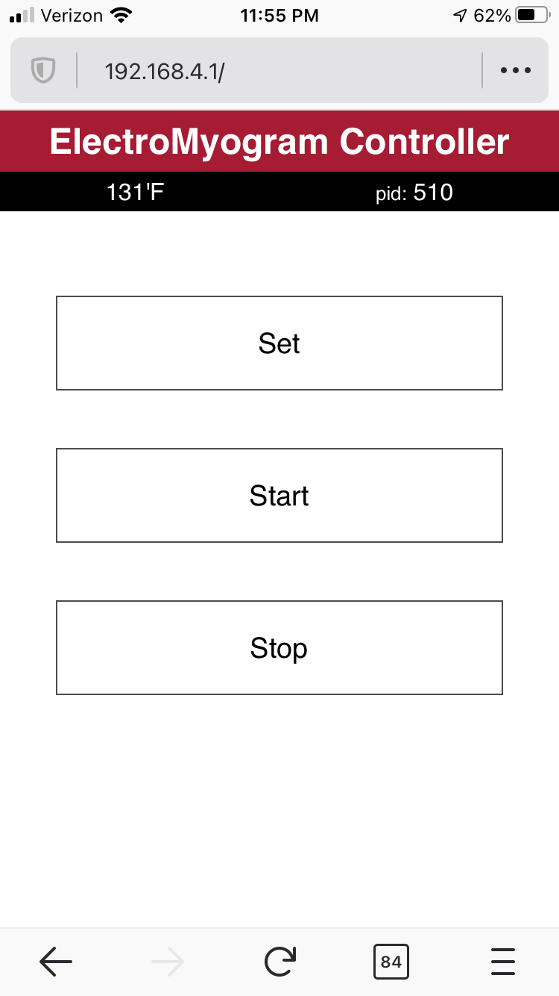
Implementation w/pictures
Raspberry Pi receives payload via xbee
Controlled via web app by user
Controls relayed to Arduino
Data stored in .CSV on 1TB SSD
192.168.4.1/data
shows all recorded csv's

Slide 9
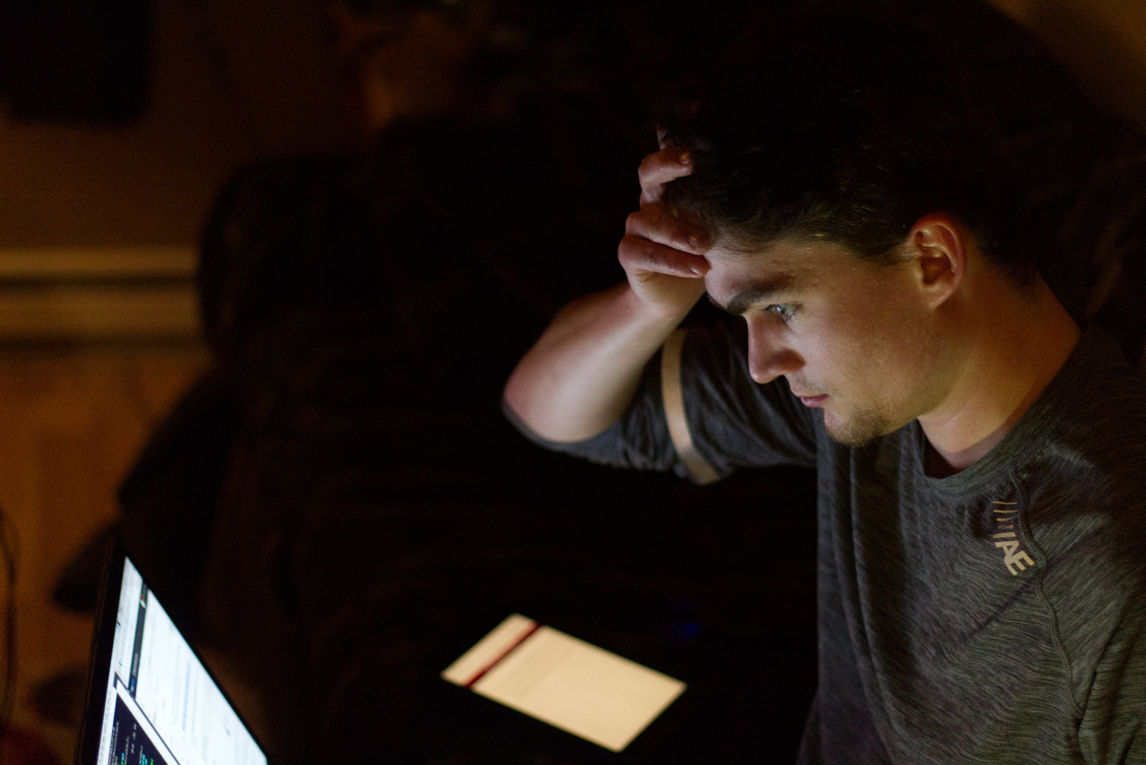
MaJor problems
Pi internal storage (SD -> SSD)
Pi restricts permissions on /tmp
Forgot to send start signal
Wire Chaos, Grounding Problems
Processes had to be owned by the same user to communicate via signals
Not enough usb ports
WLAN on Pi can not be shared
Adhoc Network
GPS Configuration/Ram Requirements
Getting equipment to CB

Slide 10
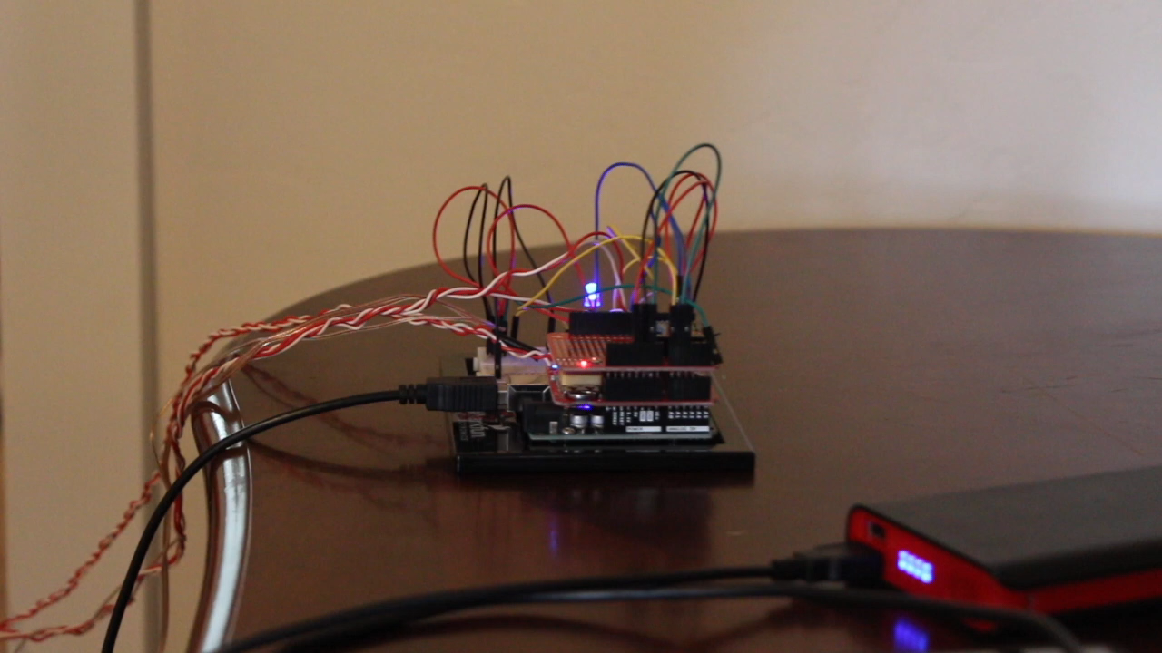
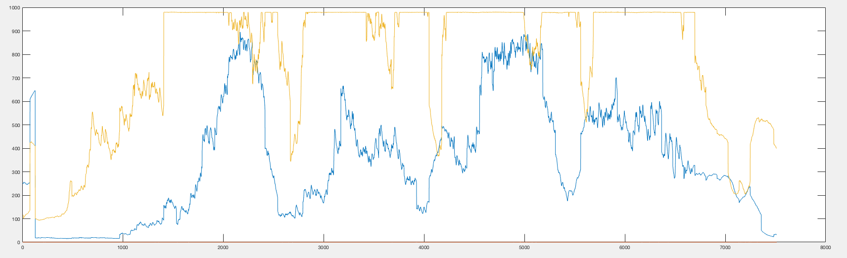
Testing

Slide 11
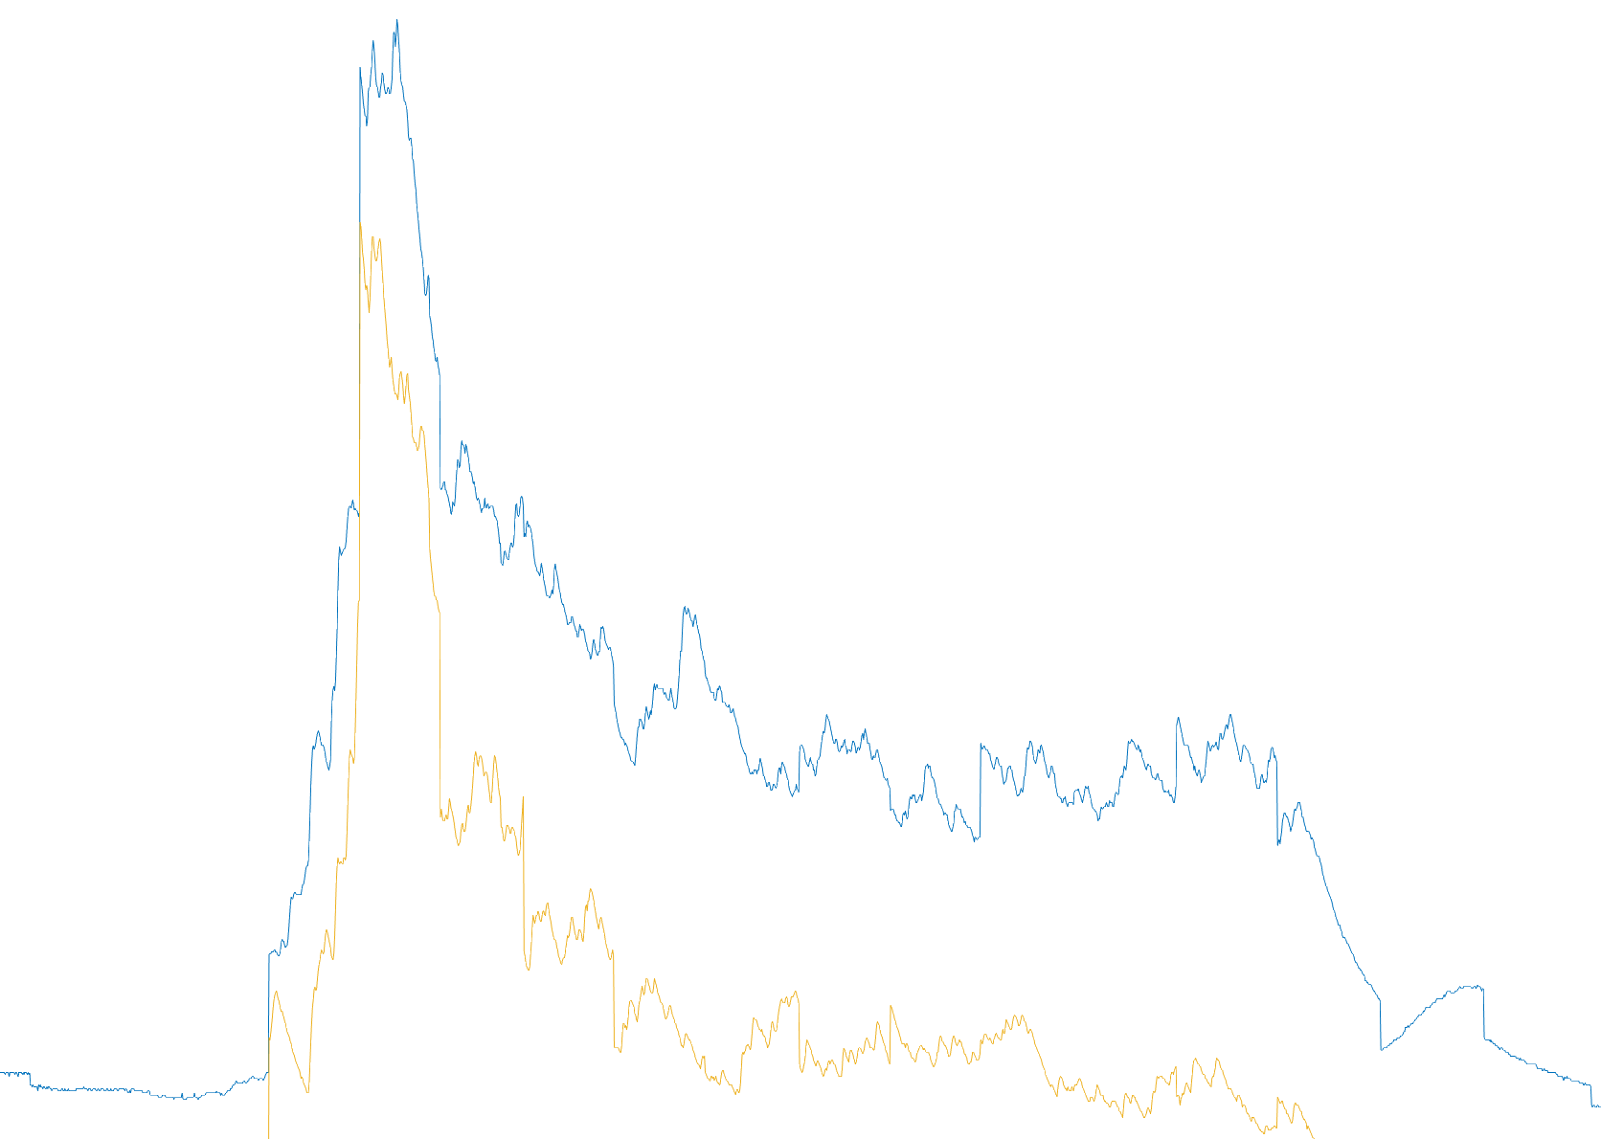
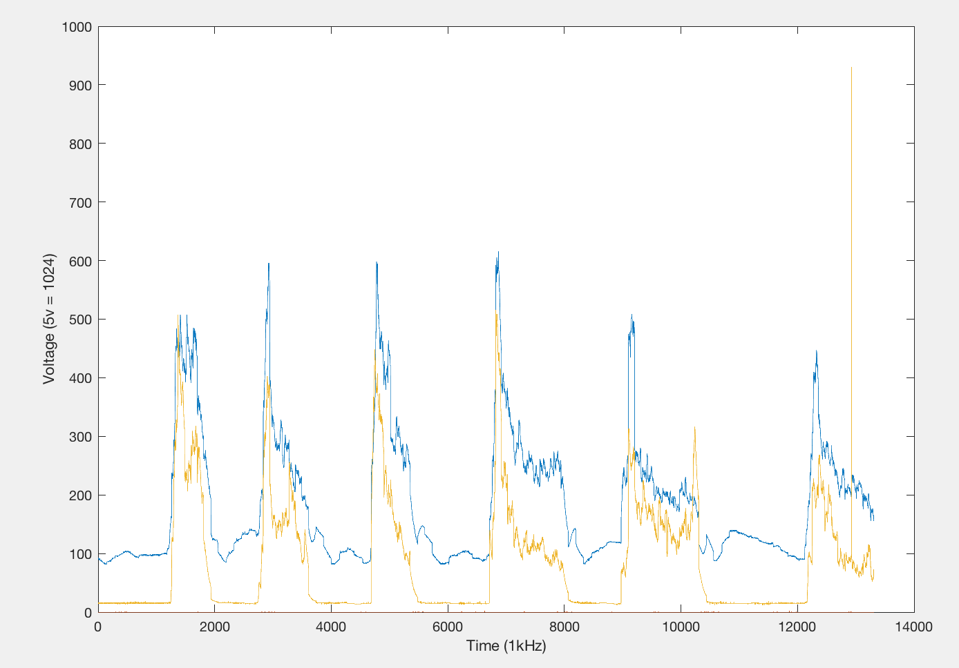
Results
Two forearms recorded together
~2 seconds of data
From 2 muscles
That's All Folks...
Questions?

